Slide 1
Digital payment Transactions
Power BI specialist – DEPI final project

Slide 2
Contents
01
02
03
Data Preparation with Power Query
Data Overview
Data Visualization in Power BI

Slide 3
01
Data Preparation with Power Query

Slide 4
How We prepare Data for Analysis?
Check Data
Clean Data
Edit Data
Remove
Duplicate rows
Promote
Headers title
Replace
UPI to unified payments interface
Replace
errors
Remove
Blank rows
change
Data type of date

Slide 5
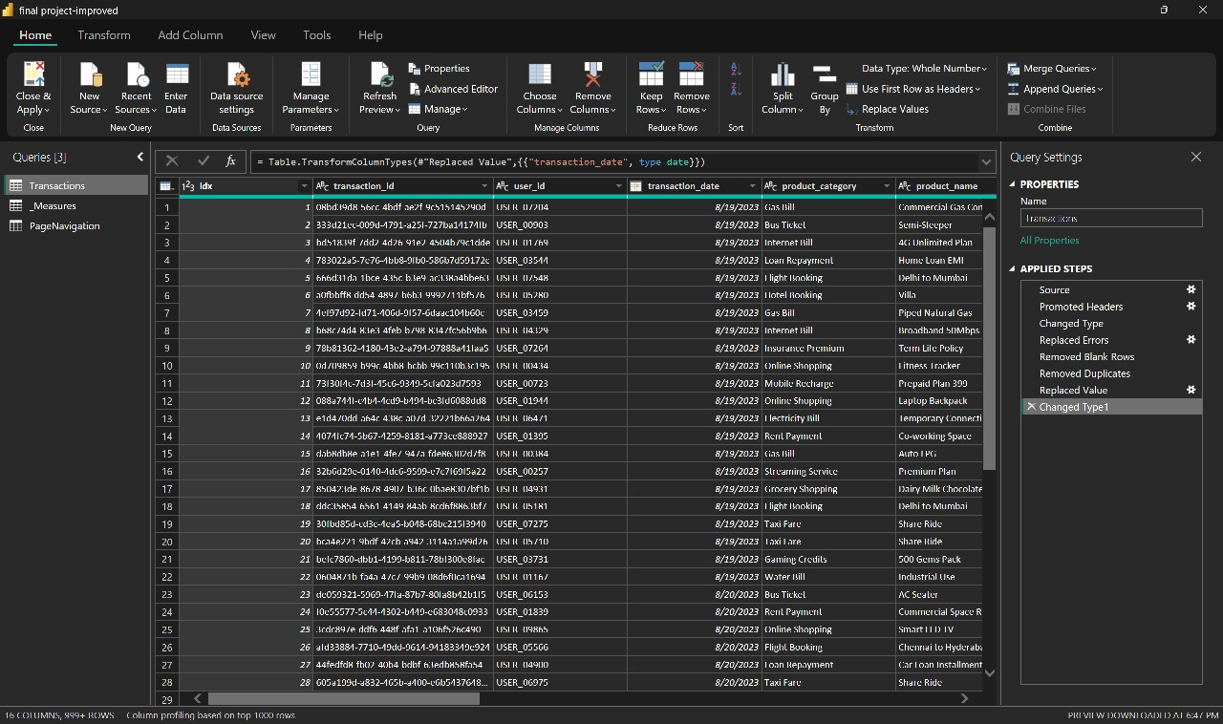
Process

Slide 6
02
Data-Overview

Slide 7
24.92M
253.32K
Total revenue
Total cash back
5000
127.79K
Tran-count
Total transaction fee

Slide 8
253.32K
25.16
Merchant cashback burned
Avg_fee_merchant
4.98K
95.5%
Amount-per merchant
Merchant successes rate

Slide 9
4.98K
1.27
Avg spend per user
Avg_tran_user
366.00
28.86%
Seasonality index
YoY growth

Slide 10
03
Data Visualization in Power BI

Slide 11
Overview
Merchant
User & Device

Slide 12
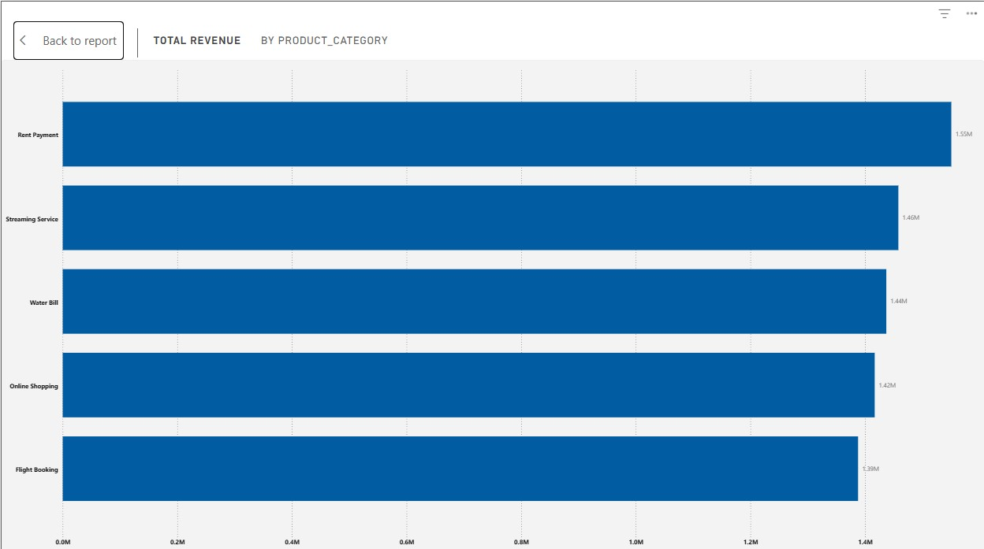
Total Revenue by product_category
Description
Rent Payment generates the highest revenue.
Horizontal bar chart ranking total revenue by product category.
Categories include:
Rent Payment (1.55M), Streaming Service
(1.46M), Water Bill (1.44M), Online Shopping
(1.42M), Flight Booking (1.39M).
Insight
Rent Payments are the top revenue contributor.
Streaming Services & Water Bills also perform strongly.
Flight Booking is the lowest category but still close to others.
Overall, revenue is distributed evenly, with no extreme outliers.

Slide 13
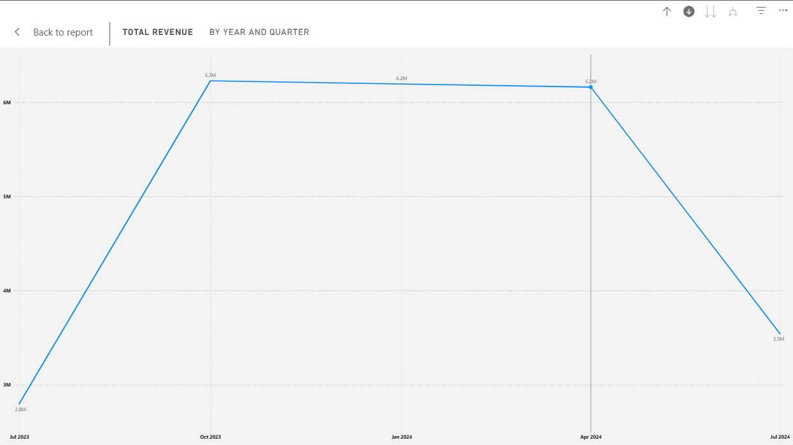
Total Revenue by Year and Quarter
Descrption
A line chart showing revenue over time. Revenue peaked and plateaued at 6.2M from Oct 2023 to April 2024, followed by a sharp crash to 3.5M in July 2024.
Insight
The company has lost nearly 45% of its quarterly revenue in the most recent quarter.

Slide 14
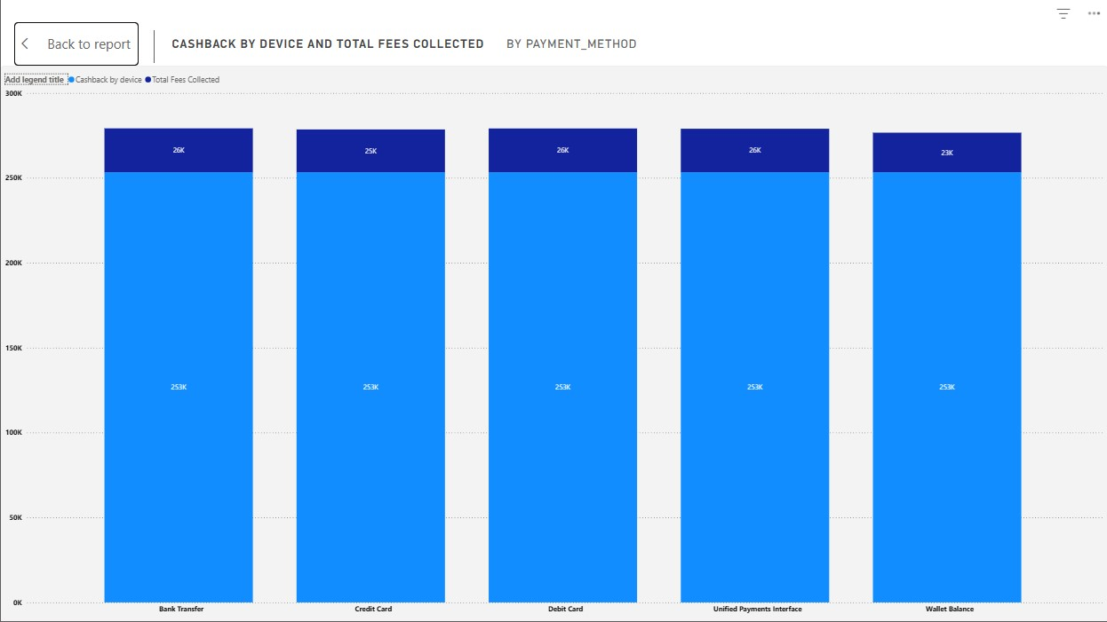
Cashback by Device & Total Fees Collected (by Payment Method)
Answer
The chart shows a stacked bar comparison of:
Cashback by device (top small dark-blue section ~25–26K)
Compared across five payment methods:
Bank Transfer, Credit Card, Debit Card, UPI, Wallet Balance.
All categories display very similar values, with almost identical total heights.
Insight
The chart shows a stacked bar comparison of:
Cashback by device (25–26K)
Total fees collected (253K)
Compared across five payment methods:
Bank Transfer, Credit Card, Debit Card, UPI, Wallet Balance.
All categories display very similar values, with almost identical total heights.

Slide 15
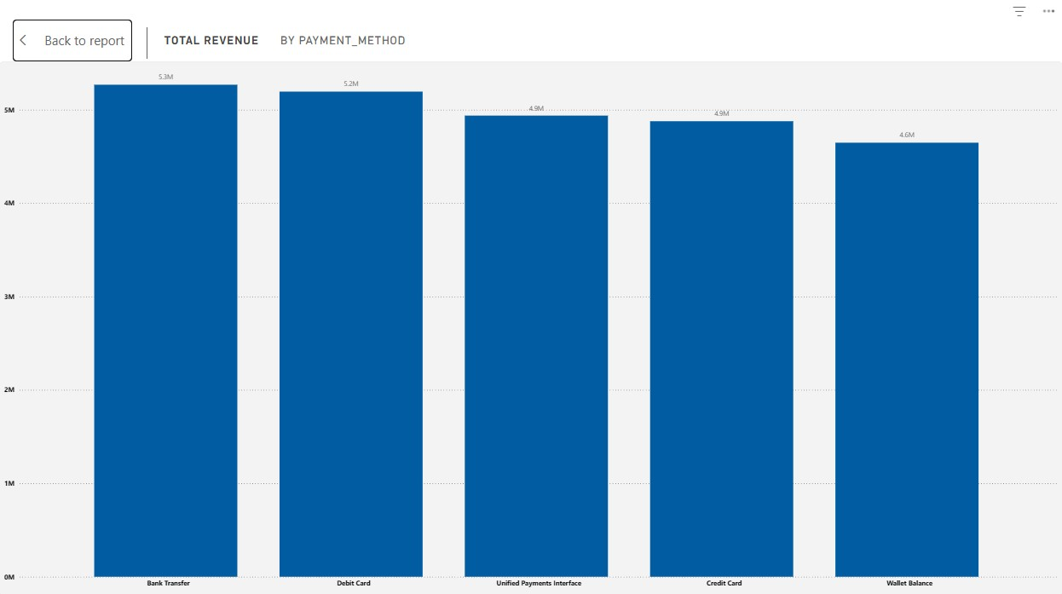
Total Revenue by Payment_Method
Description
A vertical bar chart comparing revenue across five payment methods. "Bank Transfer" leads slightly at 5.3M, closely followed by "Debit Card" (5.2M). "Wallet Balance" generates the lowest revenue at 4.6M.
Insight
The revenue distribution is remarkably flat. There is no single dominant payment channel; customers are comfortable using a wide variety of methods. However, "Wallet Balance" is the least utilized, suggesting users prefer direct withdrawal methods over storing value in the app.

Slide 16
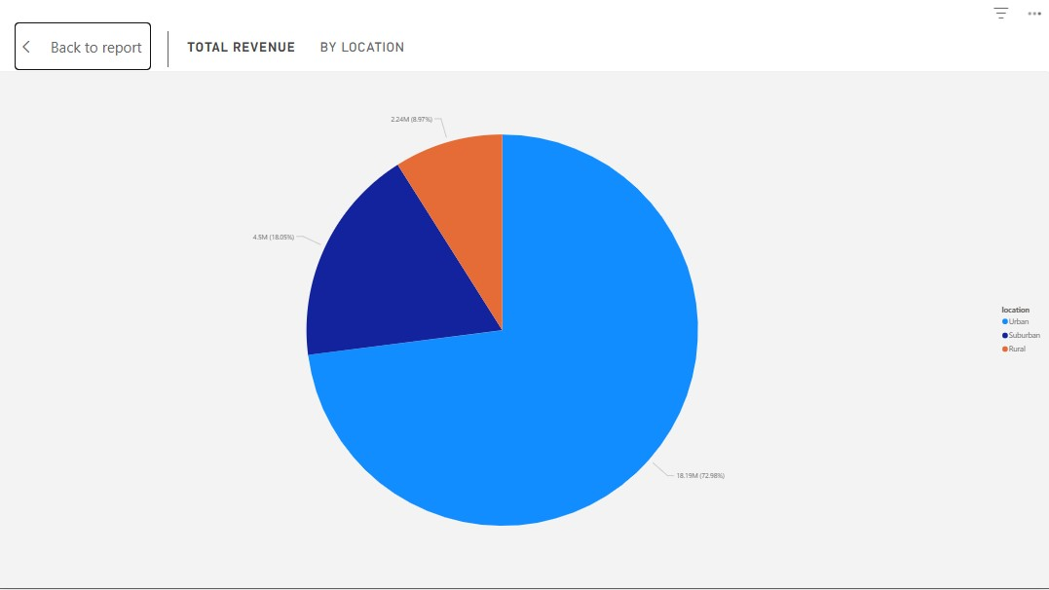
Total Revenue by Location Pie Chart
Description
A pie chart breaking down
total revenue by location.
Suburban: 18.05% (4.5M)
Rural: 8.97% (2.24M)
Urban: 72.98% (18.19M)
Insghit
Almost 73% of all revenue comes from Urban areas.

Slide 17
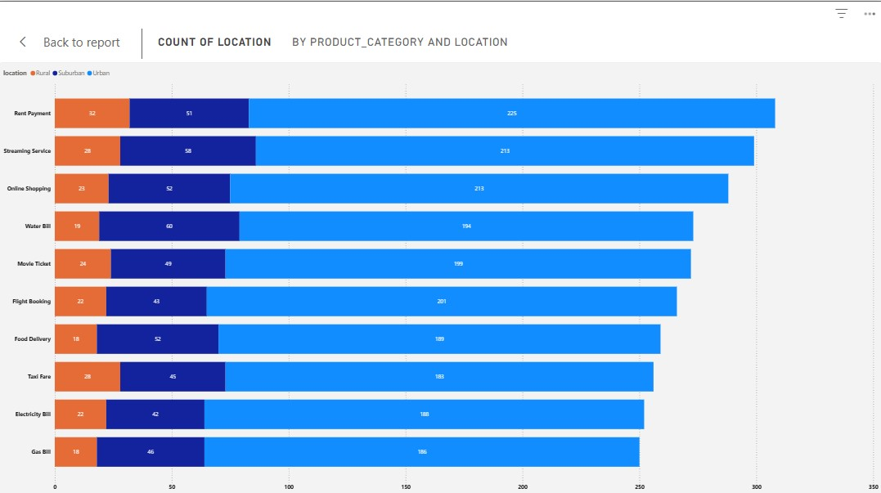
Count of Location by Product_Category
Descrption
A stacked bar chart showing transaction volume for various categories (Rent, Streaming, Shopping) split by location type. Urban users (Light Blue) overwhelmingly dominate every category.
Insghit
The product is effectively an "Urban-only" product. Rent Payment and Streaming Services are the highest volume drivers, but Rural (Orange) and Suburban (Dark Blue) segments are statistically insignificant compared to Urban usage.

Slide 18
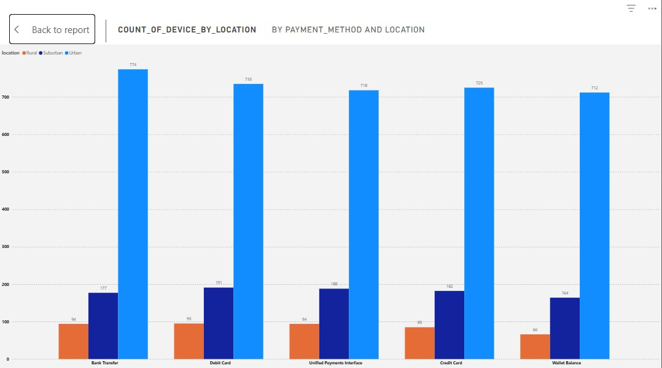
Count of Device by Location
Description
A grouped bar chart displaying the count of devices used for different payment methods, segmented by location.
Insight
The chart reinforces the findings of Slide 2. For every payment method (Bank Transfer, Debit Card, etc.), Urban usage is 4x to 7x higher than Suburban and Rural combined.

Slide 19
Overview
Merchant
User & Device

Slide 20
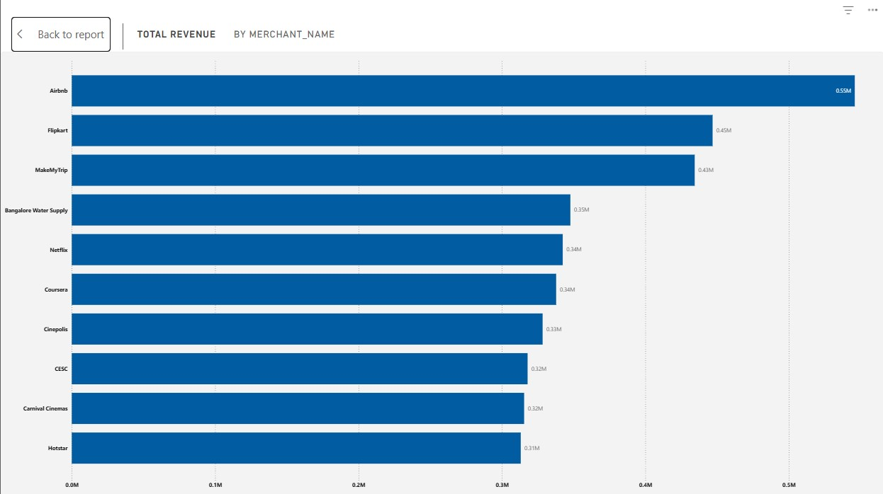
Total Revenue by Merchant_Name
Description
A horizontal bar chart ranking the top 10 merchants. Airbnb (0.55M), Flipkart (0.45M), and MakeMyTrip (0.43M) are the top three.
Insghit
Revenue is heavily driven by high-ticket discretionary spending (Travel and E-commerce). Essential services like Water Supply and Utilities (CESC) generate significantly less revenue per merchant.

Slide 21
Overview
Merchant
User & Device

Slide 22
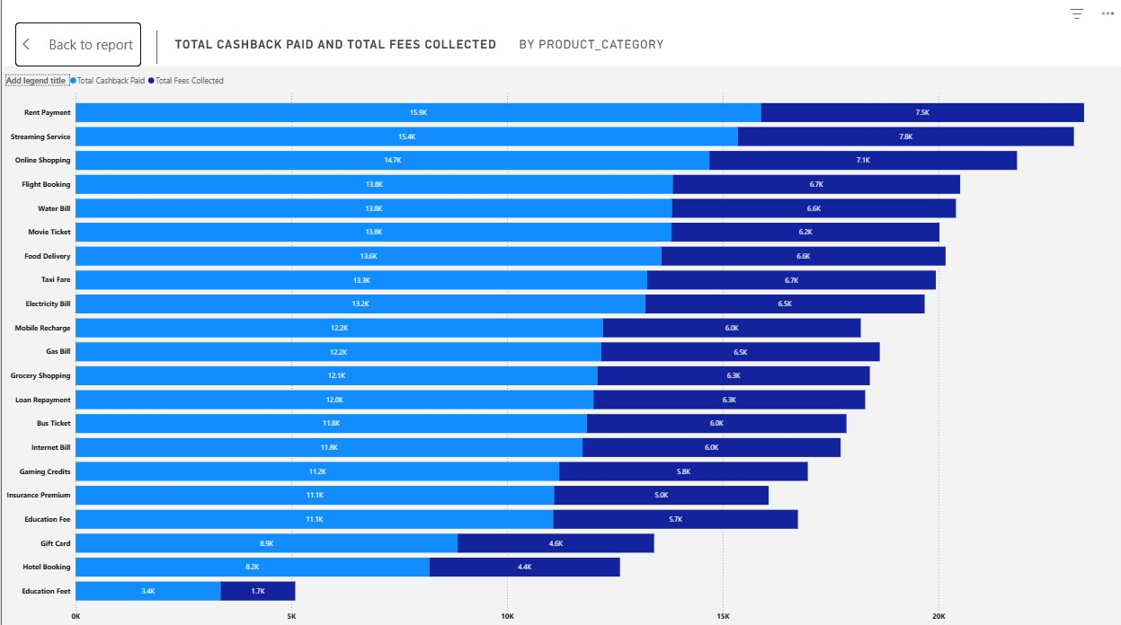
Total Cashback Paid and Total Fees Collected
Description
A bar chart comparing Cashback Paid (Light Blue) vs. Fees Collected (Dark Blue) per category.
Insghit
In almost every category, Cashback Paid is roughly double the Fees Collected. For example, in "Rent Payment," the platform pays ~15.9K in cashback to collect only ~7.5K in fees.

Slide 23
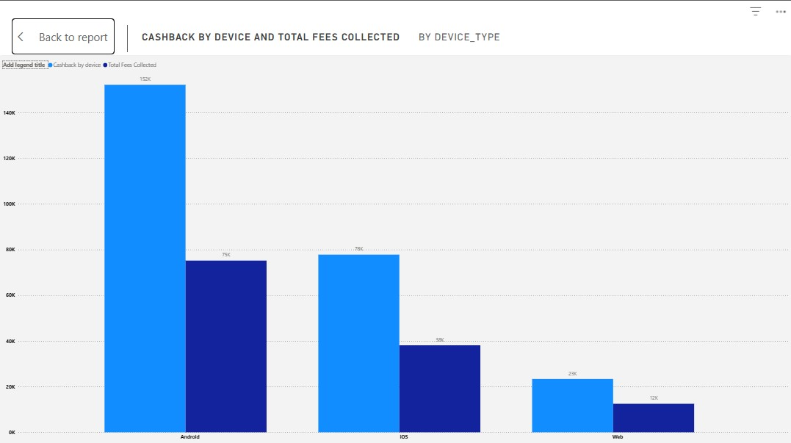
Cashback by Device and Fees Collected
Description
A grouped bar chart comparing financial performance by device type.
Android: ~152K Cashback vs ~75K Fees.
iOS: ~78K Cashback vs ~38K Fees.
Insghit
Android users drive the bulk of volume but also the bulk of the "Cash burn." The ratio of loss (2:1 Cashback to Fees) is consistent across both operating systems.

Slide 24
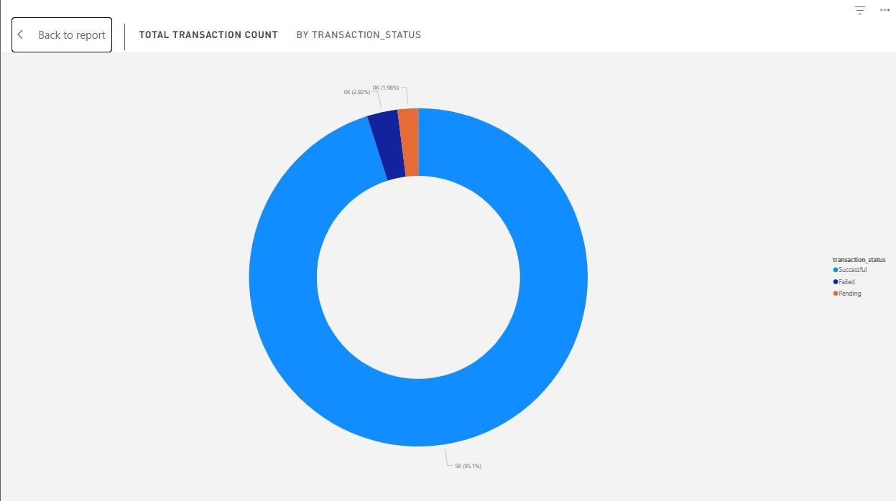
Total Transaction Count by Status
Description
A donut chart showing transaction success rates.
Successful: 95.1%
Failed: 2.92%
Pending: 1.98%
Insghit
While 95% is decent, a nearly 5% failure/pending rate is high for financial transactions. In a high-volume fintech environment, 5% represents thousands of frustrated users.

Slide 25
Thank You

Slide 26
04
Data Analysis to Answer Questions

Slide 27
Porblem statement
chart
Recmondation
Outcome

